Slide 1
Teachers Lesson Plan
Slides:
Lesson Plan
CMHW Theme
Activity 1 – What is Self - Expression
Activity 2 – Dance with Abby
Activity 3 – Match the emotions
Activity 4 – Why is expressing yourself important
Activity 5 – Sticker task
Learning objective:
To notice, name, and interpret their emotions.
1

Slide 2
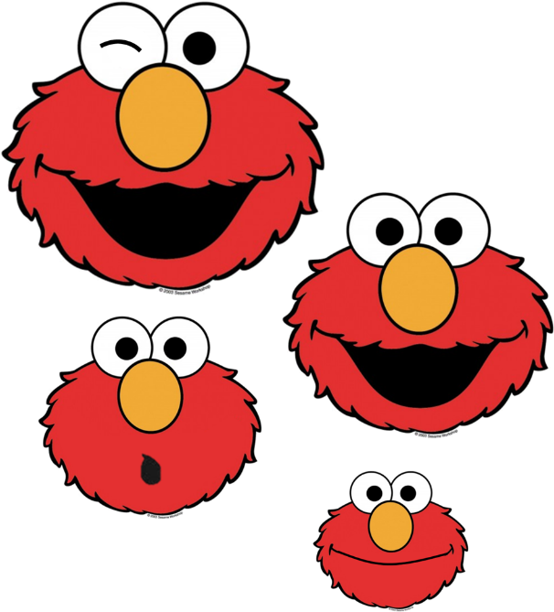
Express Yourself
Children’s Mental Health Week 2023
Activities for Nursey & Reception
“We’ve all got a messy, loud, weird part of ourselves hidden away. And a lot of us never let it out.”
Mei, Turning Red

Slide 3
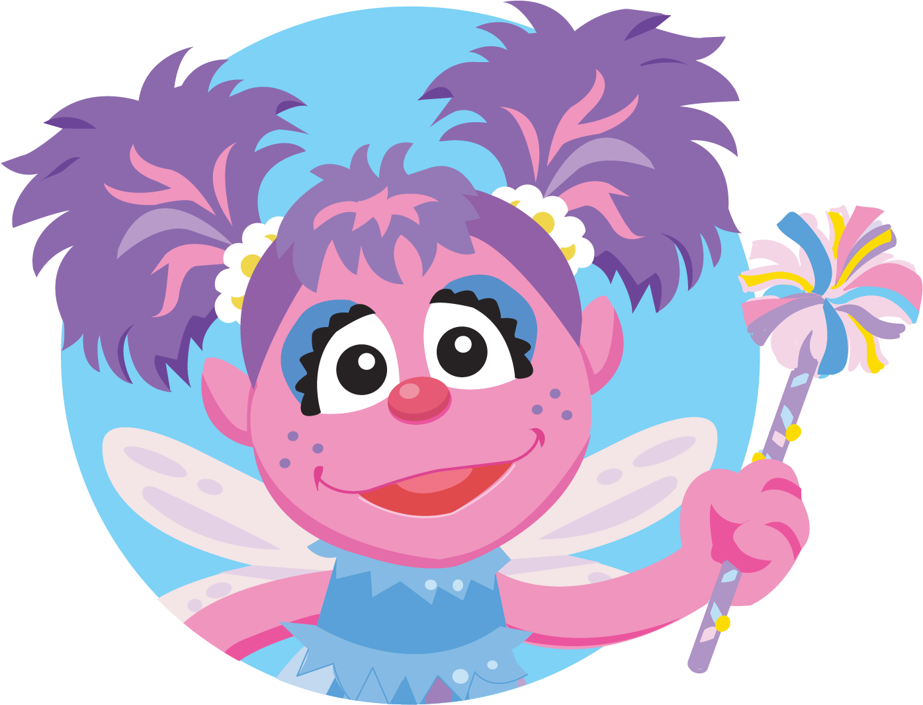
What does ‘Expressing Yourself’ mean?
Expressing yourself is when you tell and show others who you are.
You can express yourself through your feelings, thoughts and ideas, or through writing, art, music, and dance.
You can EVEN express yourself through the clothes you wear and the hobbies you enjoy.
Activity 1 - Can anyone tell me how they are feeling today?

Slide 4
IT’S TIME TO DANCE!
Activity 2
Can you dance along with Abby?
Lets see what emotions we can learn today.
4

Slide 5
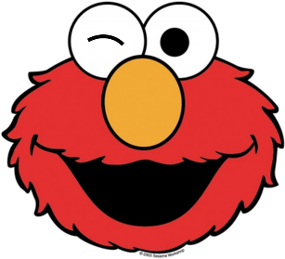
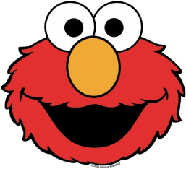
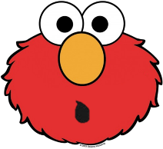
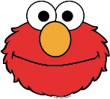
Activity 3 - Can you match Elmo’s emotion to the word?
Happy
Silly
Calm
Surprised
5

Slide 6
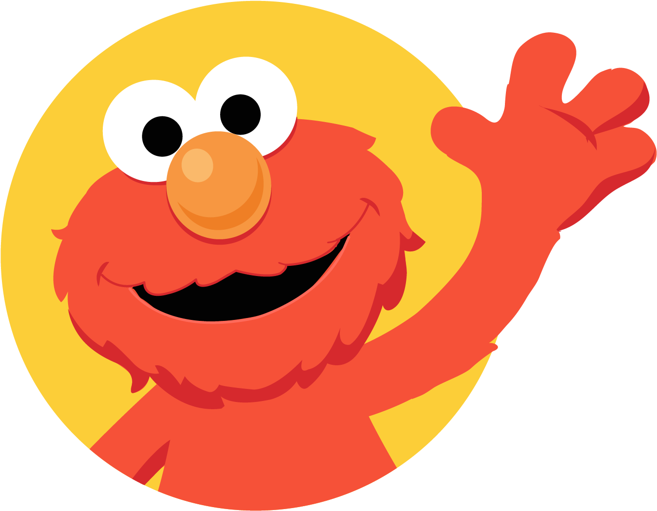
Why is expressing yourself important?
Expressing yourself is important because sometimes we have big emotions and when we notice and name these feelings we can take action to feel better.
Activity 4
Can anyone give me an example of when they last felt...
Happy
Silly
Calm
Surprised

Slide 7
Activity 6 - Stickers
It’s time to draw whatever you like on your sticker EXPRESS YOURSELF
7

