Slide 1
Teachers Lesson Plan
Slides:
Lesson Plan
CMHW Theme
What is Self – Expression
Why its important to express yourself
Activity 1 – Expressing your feelings
Activity 2 – Self Confidence
Activity 2’s Worksheet
Activity 3 – Community
Activity 5 – Superhuman Strength
Activity 5’s Worksheet
Activity 6 – Sticker
Learning objective: To notice, name, and interpret their emotions.
1

Slide 2
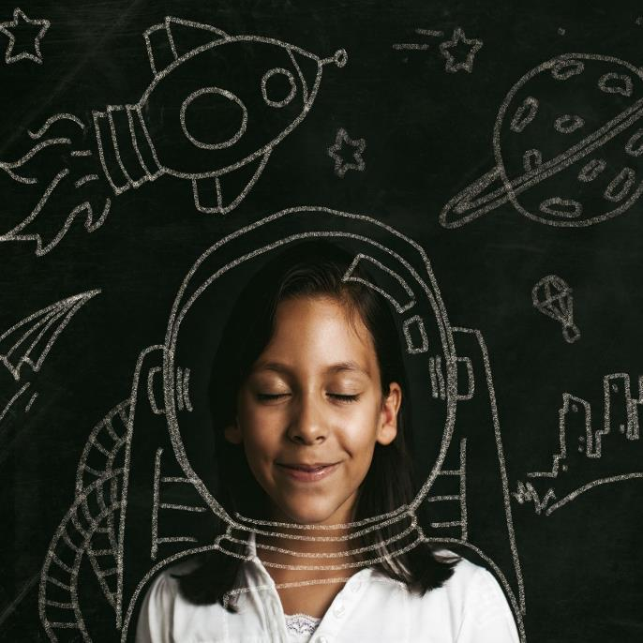
Express Yourself
Children’s Mental Health Week 2023
Activities for Nursey & Reception
“We’ve all got a messy, loud, weird part of ourselves hidden away. And a lot of us never let it out.”
Mei, Turning Red

Slide 3
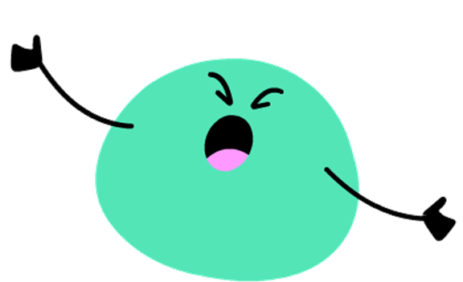
What does ‘Expressing Yourself’ mean?
Expressing yourself is when you tell and show others what you feel and who you are.
You can express yourself through your feelings, thoughts and ideas, or through writing, art, music, and dance.
You can EVEN express yourself through the clothes you wear and the hobbies you enjoy.

Slide 4
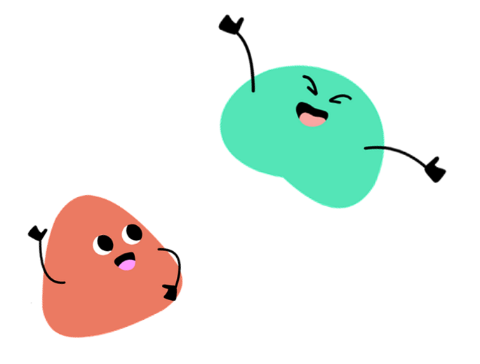
Why is expressing yourself important?
Expressing yourself is important because sometimes we have big emotions and when we notice and name these feelings we can take action to feel better.
Who can I express my feeling too?
Its important to share how your feeling with someone you trust, who will listen and take time to understand what you are saying. This may be a friend, family member, carer, teacher or any other trusted adult.

Slide 5
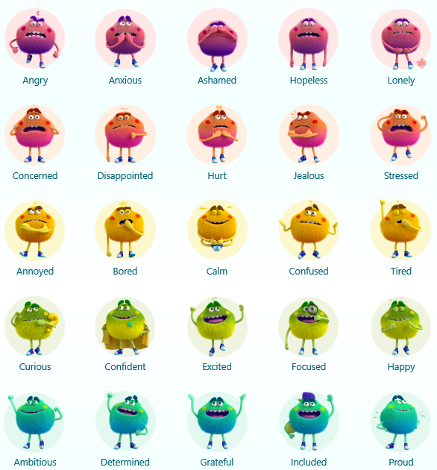
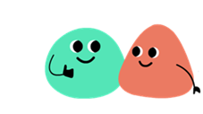
Activity 1 - Expressing Your Feelings
Activity 2
Activity:
Chose a character(s) that best describes how you're feeling today.
Talk to the person next to you about this feeling.
5

Slide 6
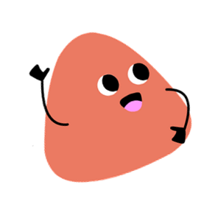
Activity 2 – Self Confidence
Activity: In your treasure chest, write 4 things you either, like about yourself or think you are good at. If this is a bit tricky, you can ask your friends or teacher for ideas.
Some Examples:
Self-confidence is having a positive attitude about your skills and abilities. It means you accept who you are and trust yourself.
I like my smile
I am good at sports
I like my personality
I am a great friend
6

Slide 7
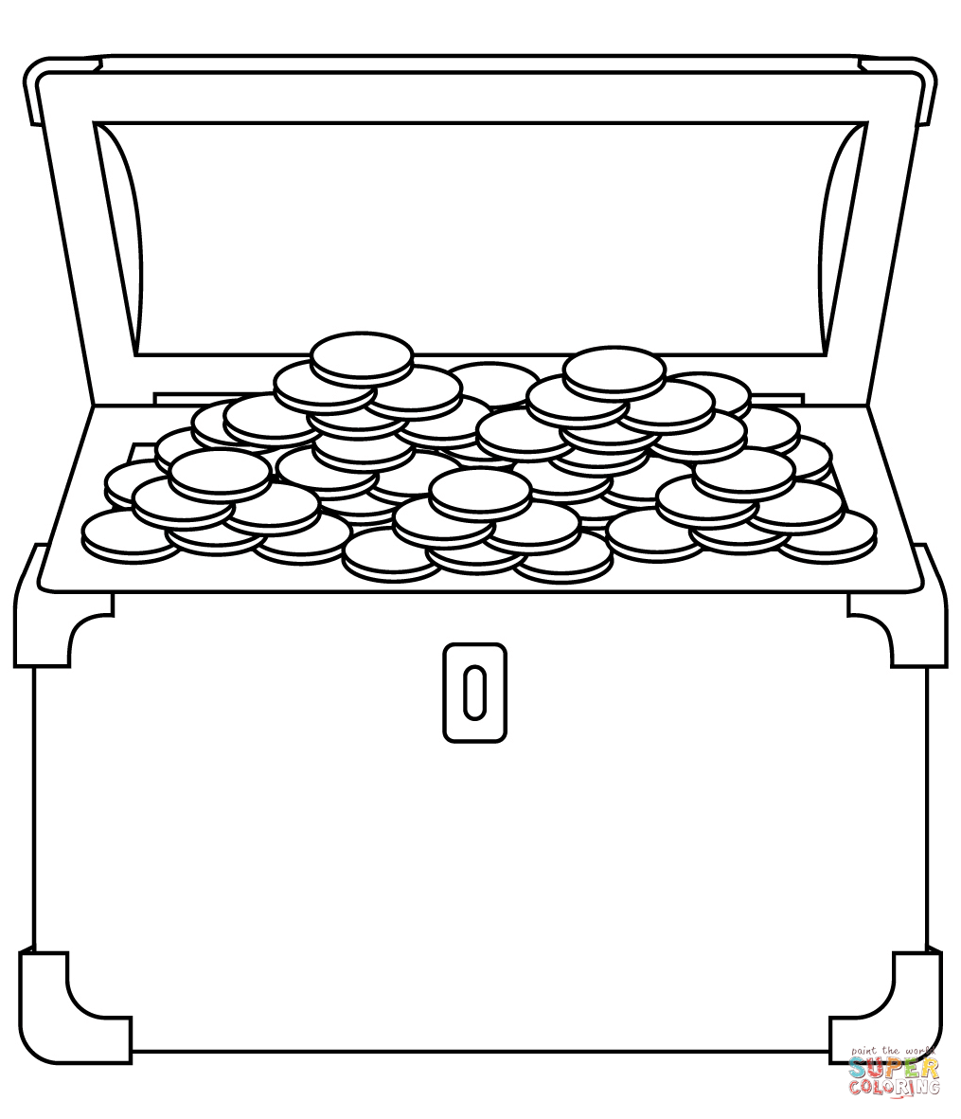
Activity 2 –Worksheet Self Confidence
Activity: In your treasure chest, write 4 things you either, like about yourself or think your good at.
This might be a bit tricky, you can ask your friends or teacher for ideas.

Slide 8
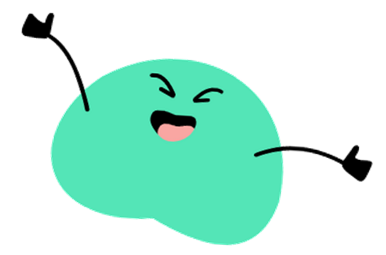
Activity 3 – Our Class Community
When you are able to express yourself in your own community, it gives you a sense of belonging. If we imagine your class as your community, what might your class logo be?
Activity: As a whole class, create your own class logo or image that represents the class as a whole.

Slide 9
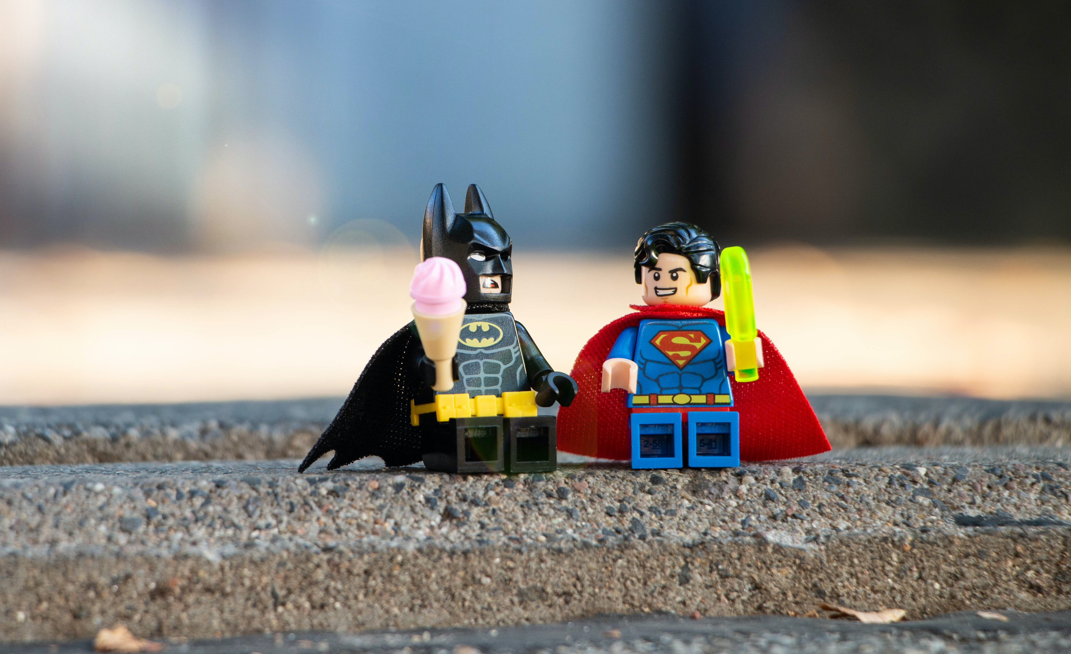
Activity 4 – Superhuman Strength
Activity: To draw and design your own superhuman that you aspire to be.
If you could be Superhuman what would your super power be?
What would you call yourself?
Who are the hero’s in your life, what abilities do they have that inspire you?
What would you stand up for?
Be the change you want to see in the world!
9

Slide 10
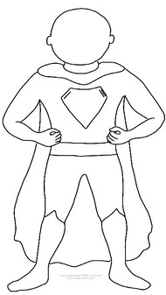
Activity 2 Worksheet - Superhuman Strength
Design and colour in your superhuman, you can add your face and hair style too. Then write about your strengths on your cape.
Superhuman Name:___________________________________________________
For example, Captain Brave, Tiger Fury, Super Socks
Special powers and abilities:
____________________________
____________________________
____________________________
____________________________
____________________________
____________________________
For example, Lightening bolts, Flying, Super strength

Slide 11
Activity 6 - Stickers
It’s time to draw whatever you like on your sticker EXPRESS YOURSELF
11

