Slide 1
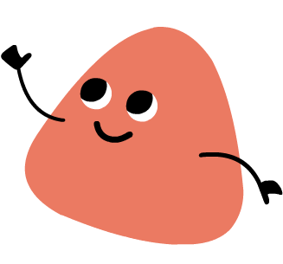
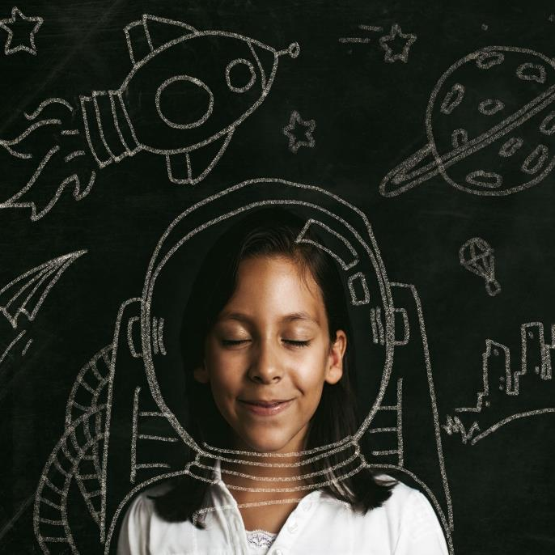
Express Yourself
Children’s Mental Health Week
6th – 12th February 2023

Slide 2
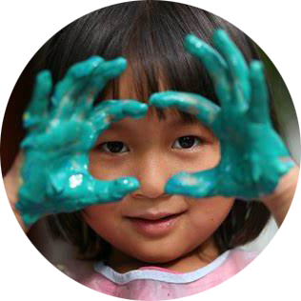
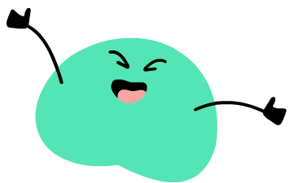
What does expressing yourself mean?
It means to show others what you feel and who you are.
“We’ve all got a messy, loud, weird part of ourselves hidden away, and a lot of us never let it out.”
Mei, Turning Red

Slide 3
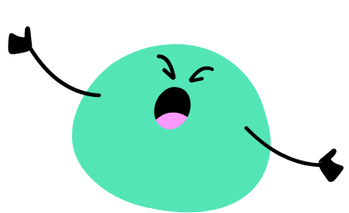
Why is expressing yourself important?
It is important because sometimes we have big emotions and when we notice and name these feelings we can take action to get the support we need and to feel better.
“Let it in, let it out,
let it rain, let it snow,
let it go.”
Bruno, Encanto

Slide 4
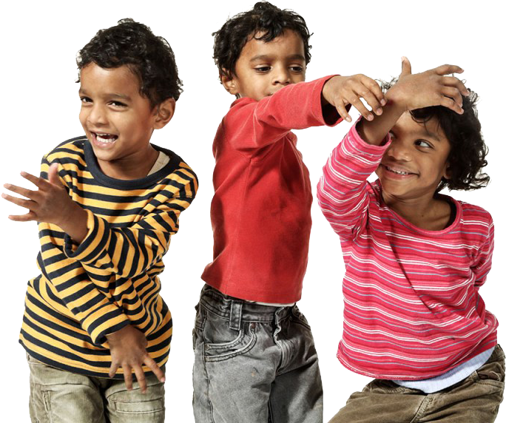
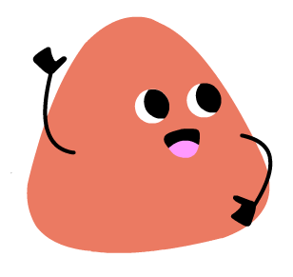
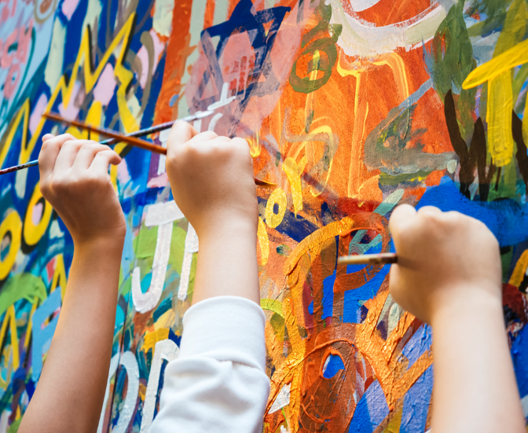
How can you express yourself?
There are many ways you can express yourself, take a moment to think about how you like to express yourself. Here are a few examples:
words
feelings
ideas
thoughts
writing
art
music
dance
hobbies
clothes

Slide 5
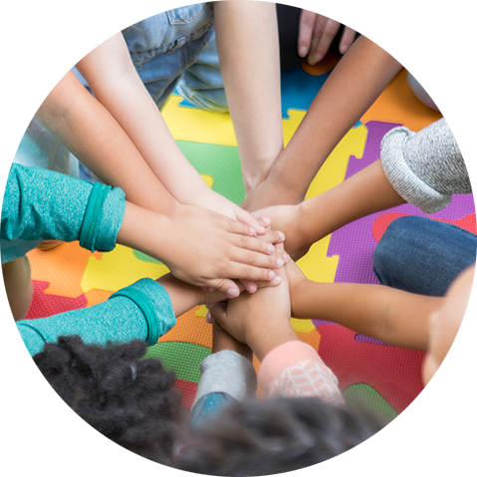
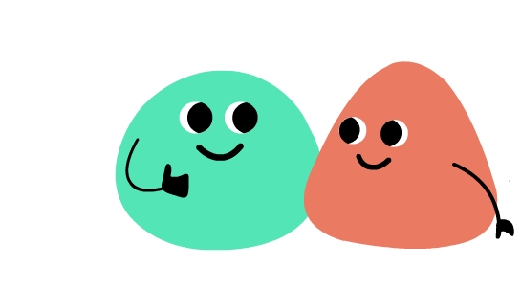
Expressing Yourself Themes
Some of the topics you might talk about with your teachers during Children’s Mental Health Week are:
Expressing your Feelings
Self Confidence
Your Class Community
Discovering your superhuman strengths

Slide 6
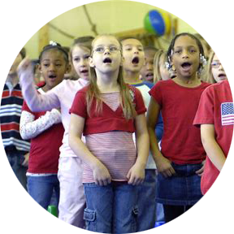
What to expect during Children’s Mental Health Week
You will see “Express Yourself” posters around school.
You may do fun activities with your teachers and staff from Unlocking Potential (UP).
You will be given an activity pamphlet with fun puzzles and games to do at home or with friends.
You will be given an “Express Yourself” sticker to draw your feelings on.

Slide 7
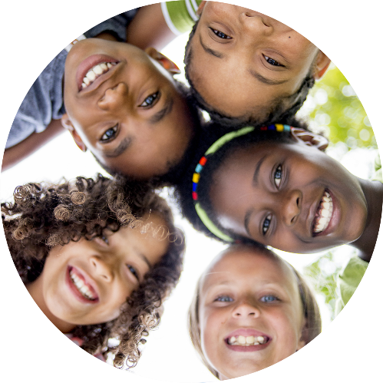
Have fun expressing yourself!
V

